Slide 1
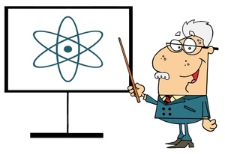
Atomic Theory
Review & Introduction for Science 10

Slide 2
Vocabulary
ATOM: smallest particle of an element, has a neutral charge.
ELEMENT: made up of 1 type of atom (eg. Oxygen, O)
COMPOUND: a pure substance made up of 2 or more elements that are bonded together.
E.g. Hydrogen and oxygen combine to form the compound water.

Slide 3
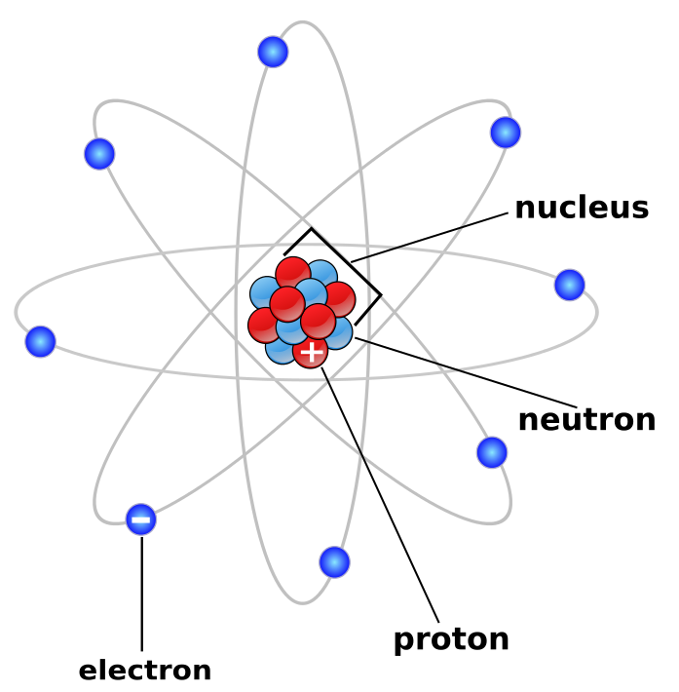
Atoms
Protons and neutrons make up the nucleus. Together, they form the mass of the atom – called the atomic mass.
The electrons spin around the outside of the nucleus in areas called shells or orbitals. Electrons are very small and do not add much to the mass of an atom.
Protons have a positive (+) charge.
Electrons have a negative (-) charge.
A neutron is neutral, meaning there is no charge.

Slide 4
Numbers to Remember
Atomic Number = Protons
Atomic Mass = Protons + Neutrons
(Neutrons = Atomic Mass – Atomic Number)
Electrons = Protons
PEN = Protons = Electrons = Number (Atomic)

Slide 5
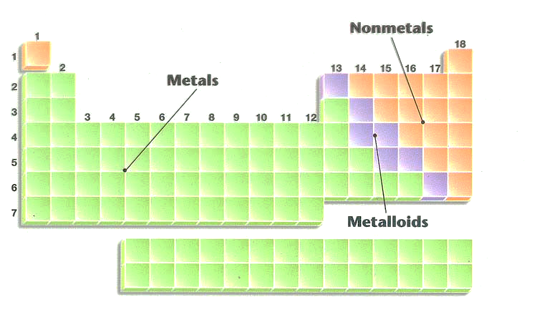
Organization of the Periodic Table
Elements are listed according to atomic number.
Vertical columns ( ) are called groups or families.
Horizontal rows ( )are called periods.
When the periodic table was organized, certain elements ended up together.
Metals are on the LEFT.
Non-metals on the RIGHT.
Metalloids are along the STAIRCASE.

Slide 6
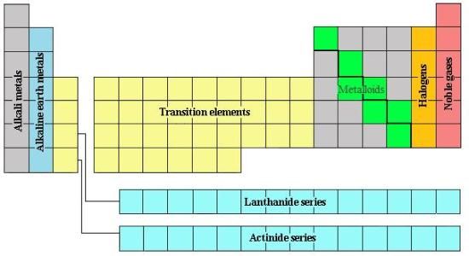
Organization of the Periodic Table
Elements in the same family have similar properties.
Group 1 = alkali metals (highly reactive)
Group 2 = alkaline earth metals (reactive)
Groups 3-12 = transition metals
Group 17 = the halogens (very reactive)
Group 18 = noble gases (unreactive)

Slide 7
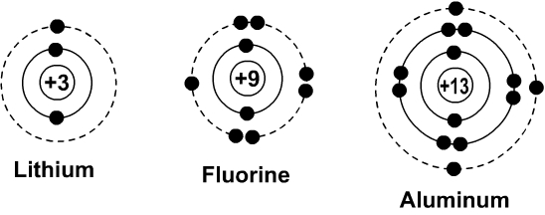
Bohr Diagrams
Are used to show how many electrons appear in each electron shell around an atom.
Each orbit can only hold a certain number of electrons. The first orbit (nearest the nucleus) will only hold 2 electrons, the second holds 8, and the third is also full when it has 8 electrons.
The number of shells in these diagrams corresponds to the period number of the element.

Slide 8
Bohr Diagrams
What element is this?
It has 2 + 8 + 8 = 18 electrons, and therefore 18 protons
_{18 p}
^{22 n}
Argon!

Slide 9
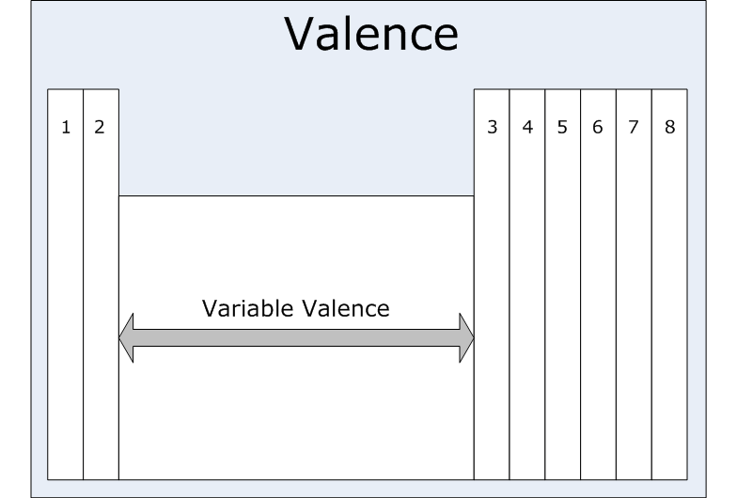
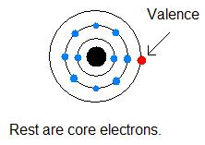
Valence Electrons
The electrons in the outermost shell (valence shell) are called the valence electrons.
Elements in each chemical family have the same number of valence electrons.

Slide 10
Lewis Structures
Only valence electrons are shown.
Dots representing valence electrons are placed around the element symbols (on 4 sides, imagine a box around the symbol).
Electron dots are placed singularly, then they are paired.

Slide 11
Let’s Practice Now…

